Slide 1
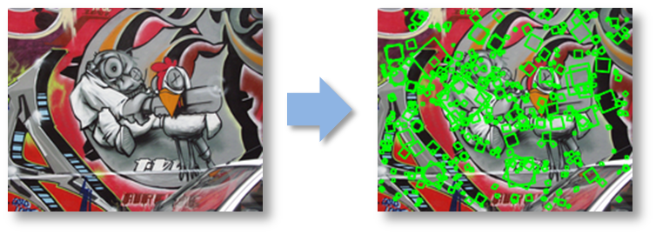
Local features & Harris corner detection
CS5187: Vision & Image

Slide 2
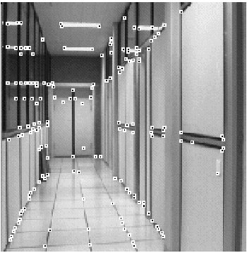
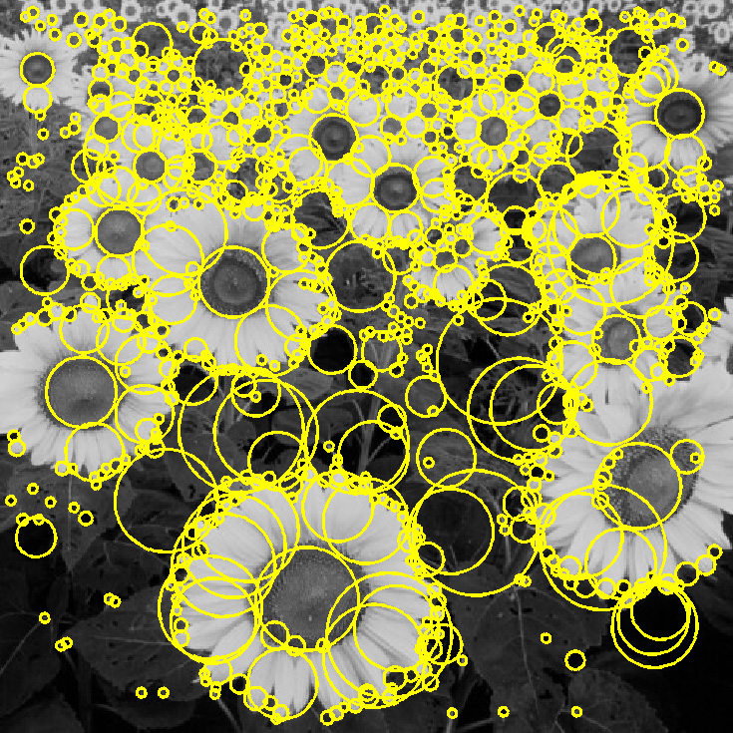
Today: Feature extraction—Corners and blobs

Slide 3
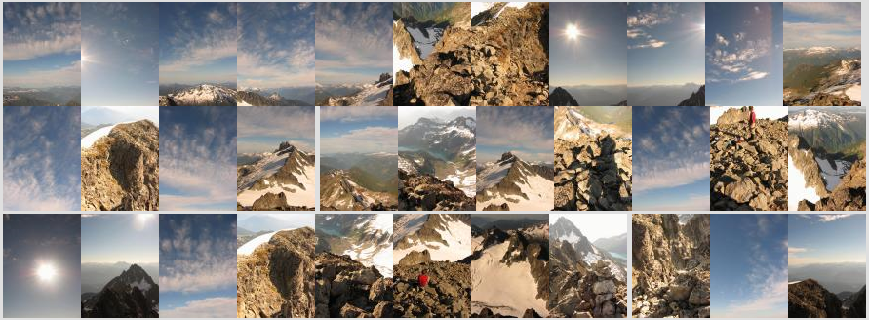

Motivation: Automatic panoramas
Credit: Matt Brown

Slide 4
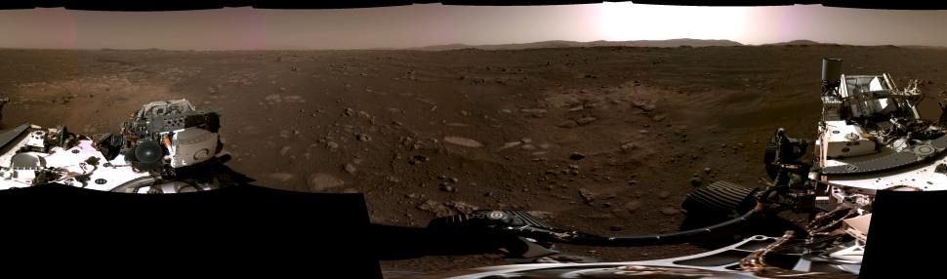
Panorama stitching
Panorama captured by Perseverence Rover, Feb. 20, 2021
https://www.space.com/nasa-perseverance-rover-first-panorama-mars

Slide 5

Motivation: Automatic panoramas
GigaPan:
http://gigapan.com/
Also see Google Zoom Views:
https://www.google.com/culturalinstitute/beta/project/gigapixels

Slide 6
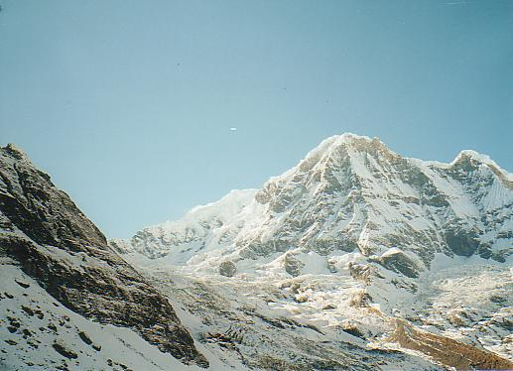
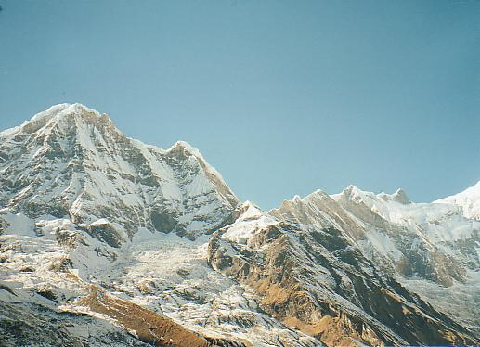
Why extract features?
Motivation: panorama stitching
  We have two images – how do we combine them?

Slide 7
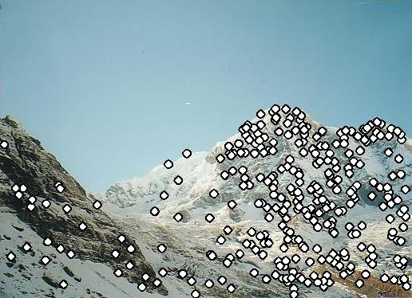
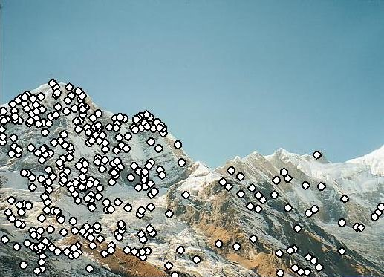
Why extract features?
Motivation: panorama stitching
  We have two images – how do we combine them?
Step 1: extract features
Step 2: match features

Slide 8
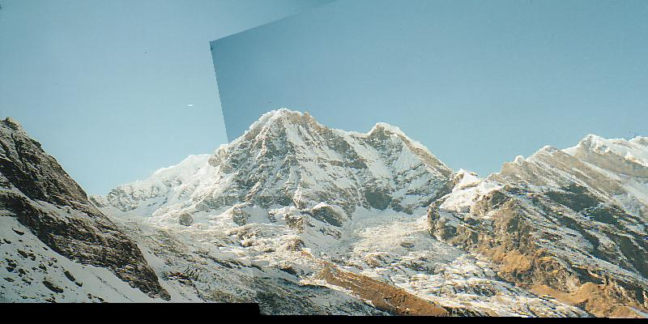
Why extract features?
Motivation: panorama stitching
  We have two images – how do we combine them?
Step 1: extract features
Step 2: match features
Step 3: align images

Slide 9
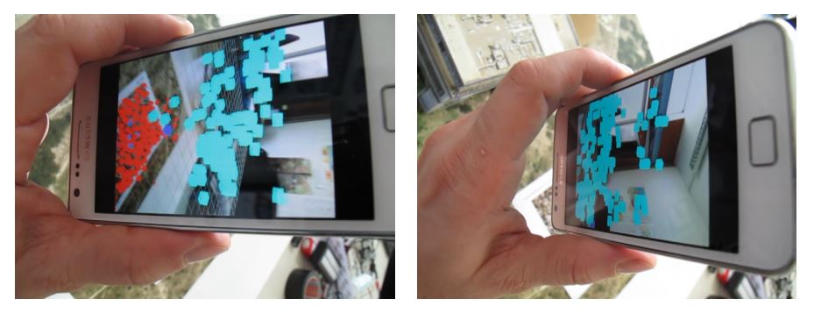
Application: Visual SLAM
(aka Simultaneous Localization and Mapping)

Slide 10
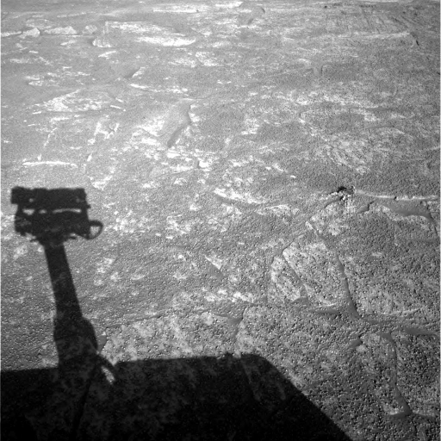
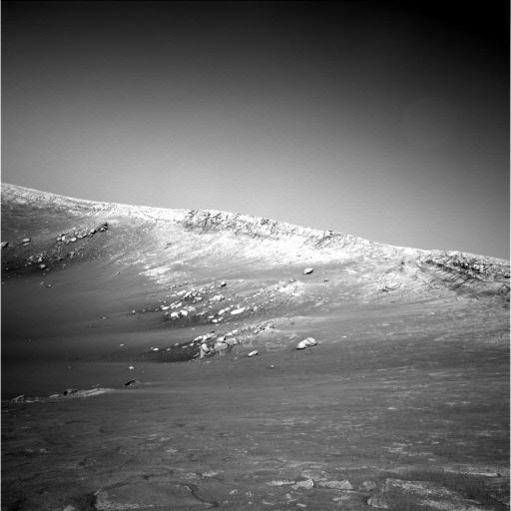
Do these images overlap?

Slide 11
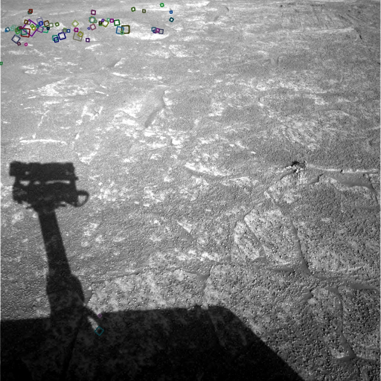
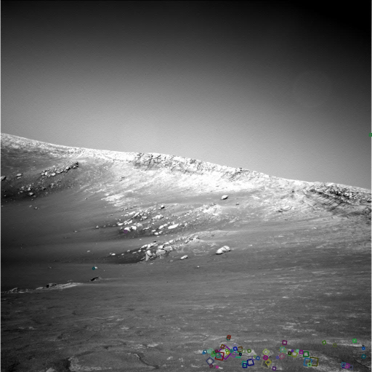
Answer below (look for tiny colored squares…)
NASA Mars Rover images
with SIFT feature matches

Slide 12
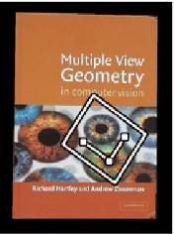

Feature matching for object search

Slide 13


Feature matching

Slide 14
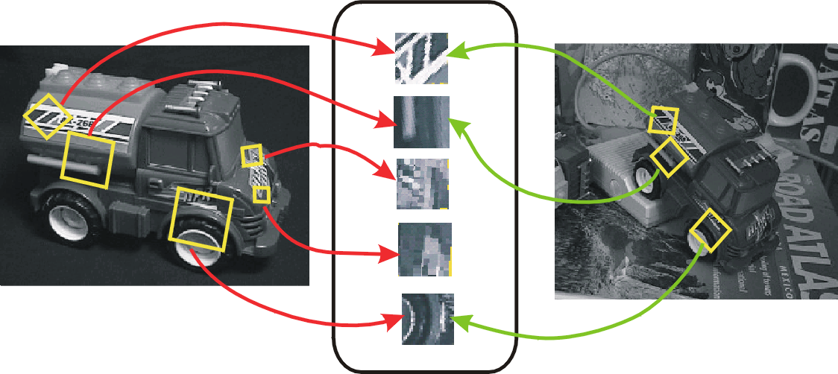
Invariant local features
Find features that are invariant to transformations
  geometric invariance: translation, rotation, scale
  photometric invariance: brightness, exposure, …
Feature Descriptors

Slide 15
Advantages of local features
Locality
  features are local, so robust to occlusion and clutter
Quantity
  hundreds or thousands in a single image
Distinctiveness:
  can differentiate a large database of objects
Efficiency
  real-time performance achievable

Slide 16
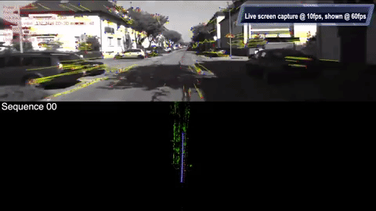
More motivation…
Feature points are used for:
  Image alignment (e.g., mosaics)
  3D reconstruction
  Motion tracking (e.g. for AR)
  Object recognition
  Image retrieval
  Robot/car navigation
  … other

Slide 17
Approach
1. Feature detection: find it
2. Feature descriptor: represent it
3. Feature matching: match it
Feature tracking: track it, when motion

Slide 18
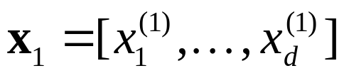
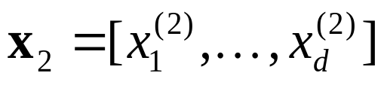


Local features: main components
Detection: Identify the interest points
Description: Extract vector feature descriptor surrounding each interest point
Matching: Determine correspondence between descriptors in two views
Credit: Kristen Grauman

Slide 19
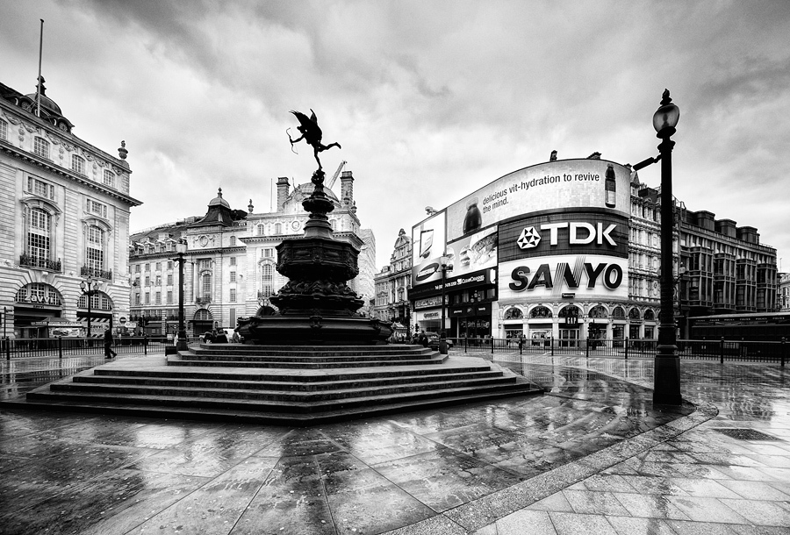
What makes a good feature?
Snoop demo

Slide 20
Want uniqueness
Look for image regions that are unusual
  Lead to unambiguous matches in other images
How to define “unusual”?

Slide 21
Local measures of uniqueness
Suppose we only consider a small window of pixels
  What defines whether a feature is a good or bad candidate?
Credit: S. Seitz, D. Frolova, D. Simakov
Notes:
High level idea is that corners are good. You want to find windows that contain strong gradients AND gradients oriented in more than one direction

Slide 22
Local measures of uniqueness
How does the window change when you shift it?
Shifting the window in any direction causes a big change
“flat” region:
no change in all directions
“edge”:
no change along the edge direction
“corner”:
significant change in all directions
Credit: S. Seitz, D. Frolova, D. Simakov

Slide 23
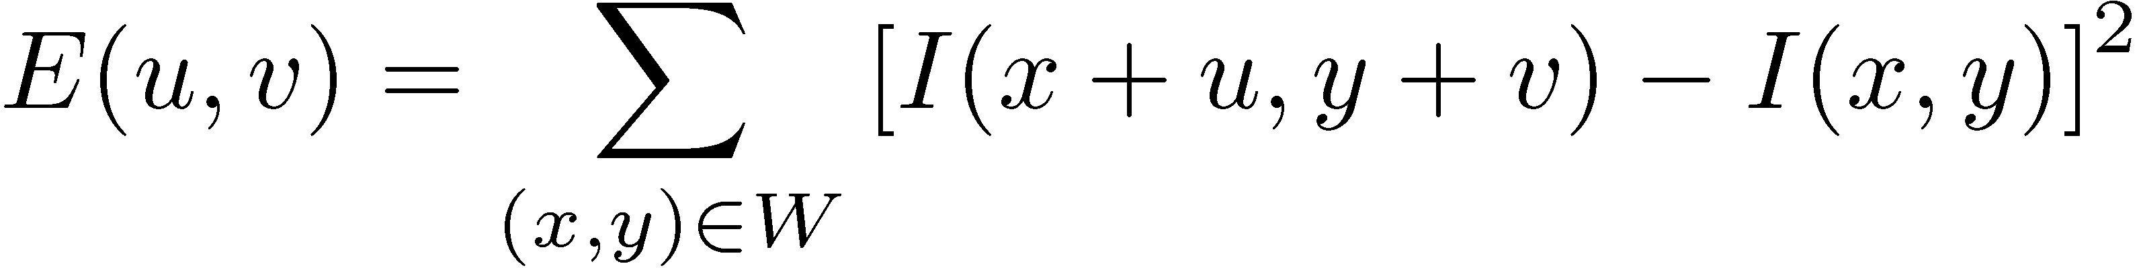
Harris corner detection: the math
Consider shifting the window W by (u,v)
  how do the pixels in W change?
  compare each pixel before and after by
  summing up the squared differences (SSD)
  this defines an SSD “error” E(u,v):
  We are pretty happy if this error is high for some offset (u, v)
  We are very happy if this error is high for all offsets (u,v)
  But, slow to compute exactly for each pixel and each offset (u,v)
_{(u,v)}
W
Chris Harris and Mike Stephens (1988). "A Combined Corner and Edge Detector". Alvey Vision Conference.

Slide 24
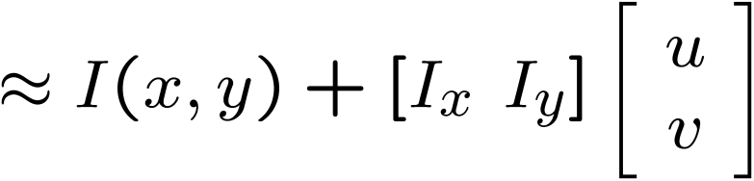
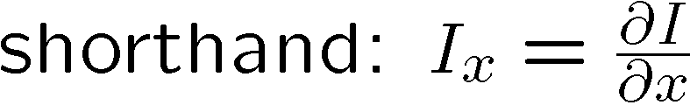
Small motion assumption
Taylor Series expansion of I:
If the motion (u, v) is small, then first order approximation is good
Plugging this into the formula on the previous slide…

Slide 25
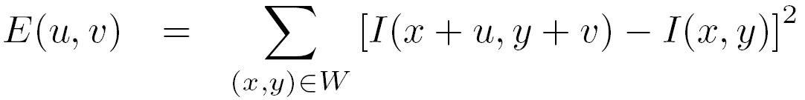
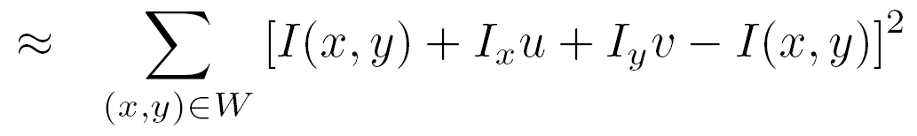
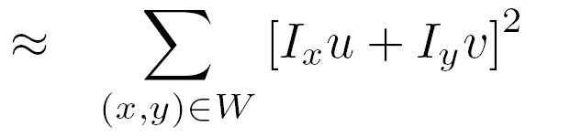
Corner detection: the math
Consider shifting the window W by (u,v)
  define an SSD “error” E(u,v):
_{(u,v)}
W

Slide 26
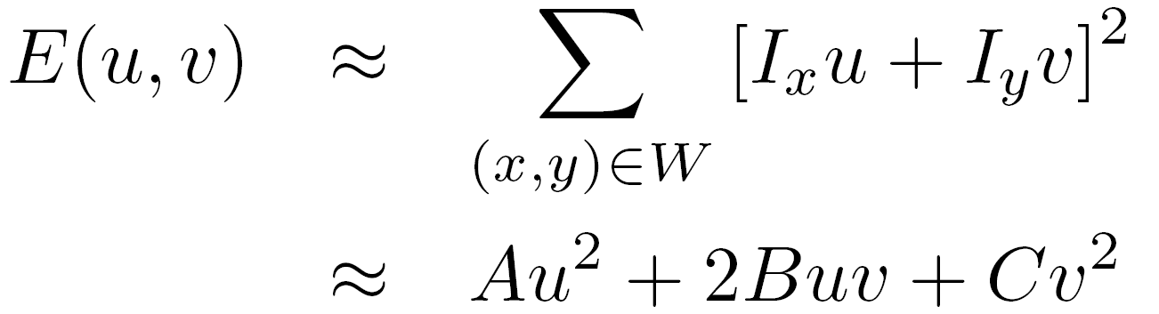
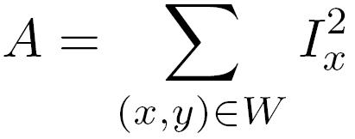
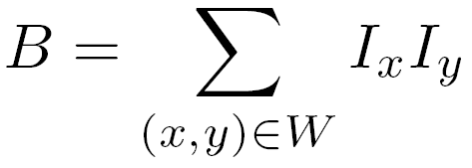
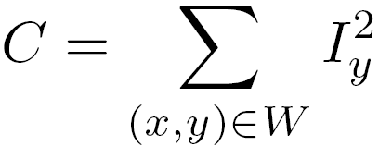
Corner detection: the math
Consider shifting the window W by (u,v)
  define an SSD “error” E(u,v):
_{(u,v)}
W
  Thus, E(u,v) is locally approximated as a quadratic error function

Slide 27

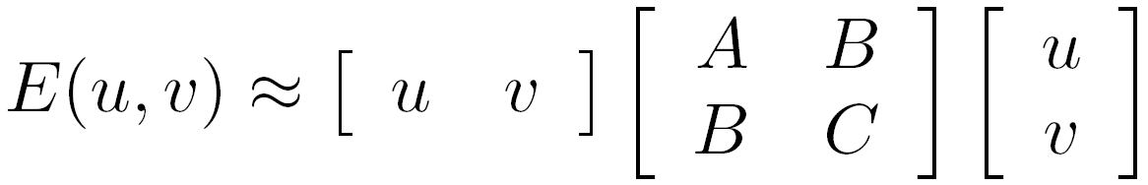

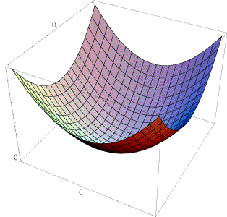
The second moment matrix
The surface E(u,v) is locally approximated by a quadratic form.
Let’s try to understand its shape.

Slide 28
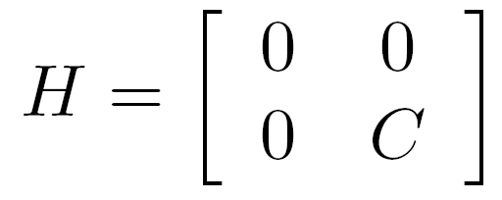
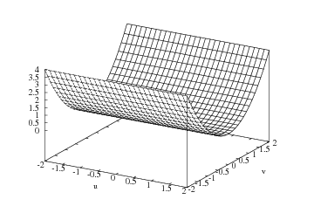

E(u,v)
Horizontal edge:
v
u

Slide 29
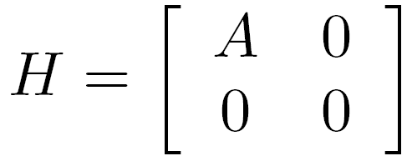
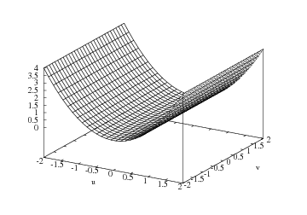

E(u,v)
Vertical edge:
v
u

Slide 30
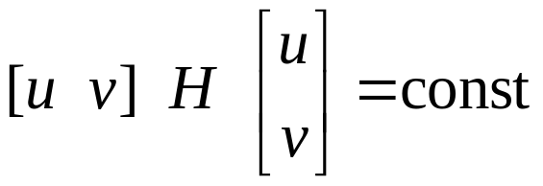
General case
We can visualize H as an ellipse with axis lengths determined by the eigenvalues of H and orientation determined by the eigenvectors of H
λ_{max}, λ_{min} : eigenvalues of H
Ellipse equation:
direction of the fastest change
direction of the slowest change
(λ_{max})^{-1/2}
(λ_{min})^{-1/2}

Slide 31

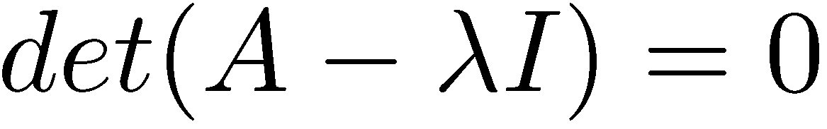
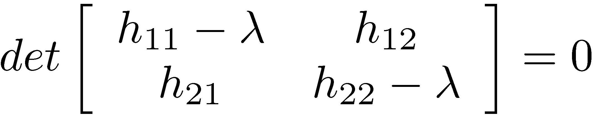
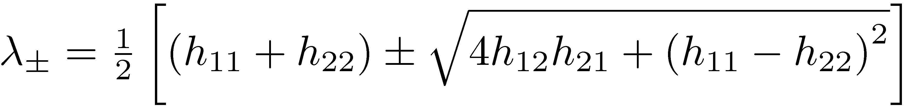
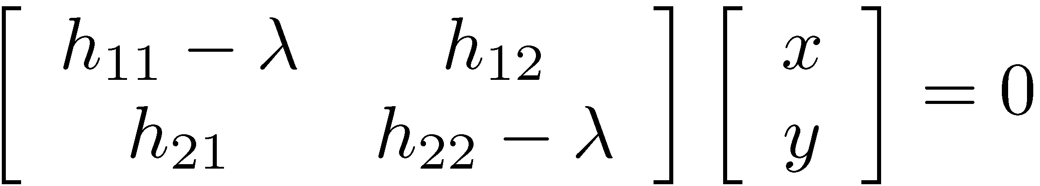
Quick eigenvalue/eigenvector review
The eigenvectors of a matrix A are the vectors x that satisfy:
The scalar λ is the eigenvalue corresponding to x
  The eigenvalues are found by solving:
  In our case, A = H is a 2x2 matrix, so we have
  The solution:
Once you know λ, you find x by solving

Slide 32
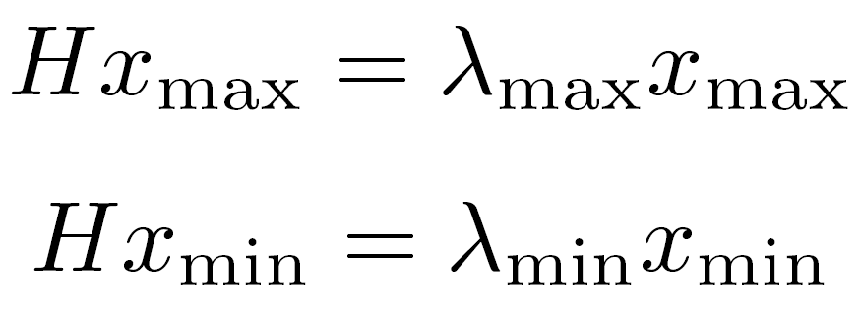
Corner detection: the math
x_{min}
x_{max}
Eigenvalues and eigenvectors of H
  Define shift directions with the smallest and largest change in error
  x_{max} = direction of largest increase in E
  λ_{max} = amount of increase in direction x_{max}
  x_{min} = direction of smallest increase in E
  λ_{min} = amount of increase in direction x_{min}

Slide 33
Corner detection: the math
How are λ_{max}, x_{max}, λ_{min}, and x_{min} relevant for feature detection?
  What’s our feature scoring function?

Slide 34

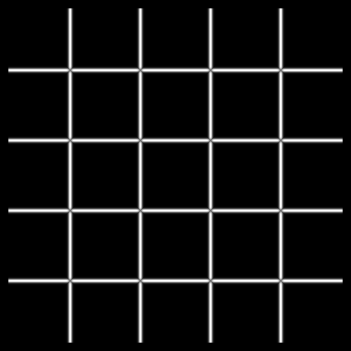


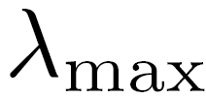
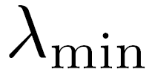
Corner detection: the math
How are λ_{max}, x_{max}, λ_{min}, and x_{min} relevant for feature detection?
  What’s our feature scoring function?
Want E(u,v) to be large for small shifts in all directions
  the minimum of E(u,v) should be large, over all unit vectors [u v]
  this minimum is given by the smaller eigenvalue (λ_{min}) of H

Slide 35
Interpreting the eigenvalues
Classification of image points using eigenvalues of M:
λ₂
“Edge”
λ₂ >> λ₁
“Corner”
λ₁ and λ₂ are large,
λ₁ ~ λ₂;
E increases in all directions
λ₁ and λ₂ are small;
E is almost constant in all directions
“Flat” region
“Edge”
λ₁ >> λ₂
λ₁

Slide 36
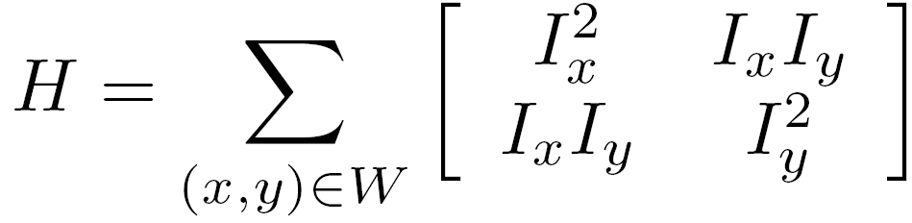
Corner detection summary
Here’s what you do:
  Compute the gradient at each point in the image
  For each pixel:
    Create the H matrix from nearby gradient values
    Compute the eigenvalues.
    Find points with large response (λ_{min} > threshold)
  Choose those points where λ_{min} is a local maximum as features

Slide 37

Corner detection summary
Here’s what you do:
  Compute the gradient at each point in the image
  For each pixel:
    Create the H matrix from nearby gradient values
    Compute the eigenvalues.
    Find points with large response (λ_{min} > threshold)
  Choose those points where λ_{min} is a local maximum as features

Slide 38
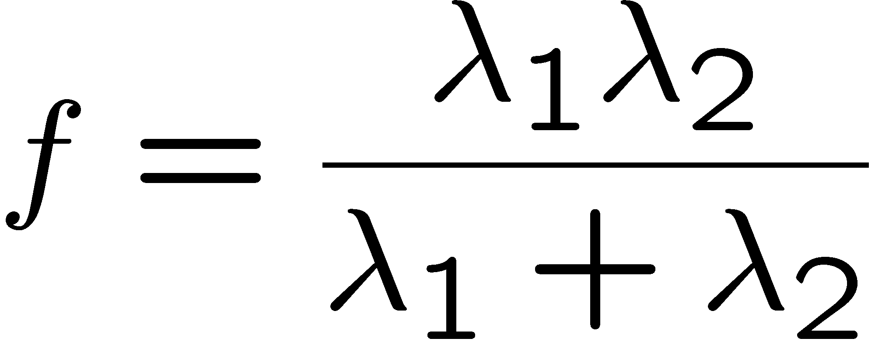
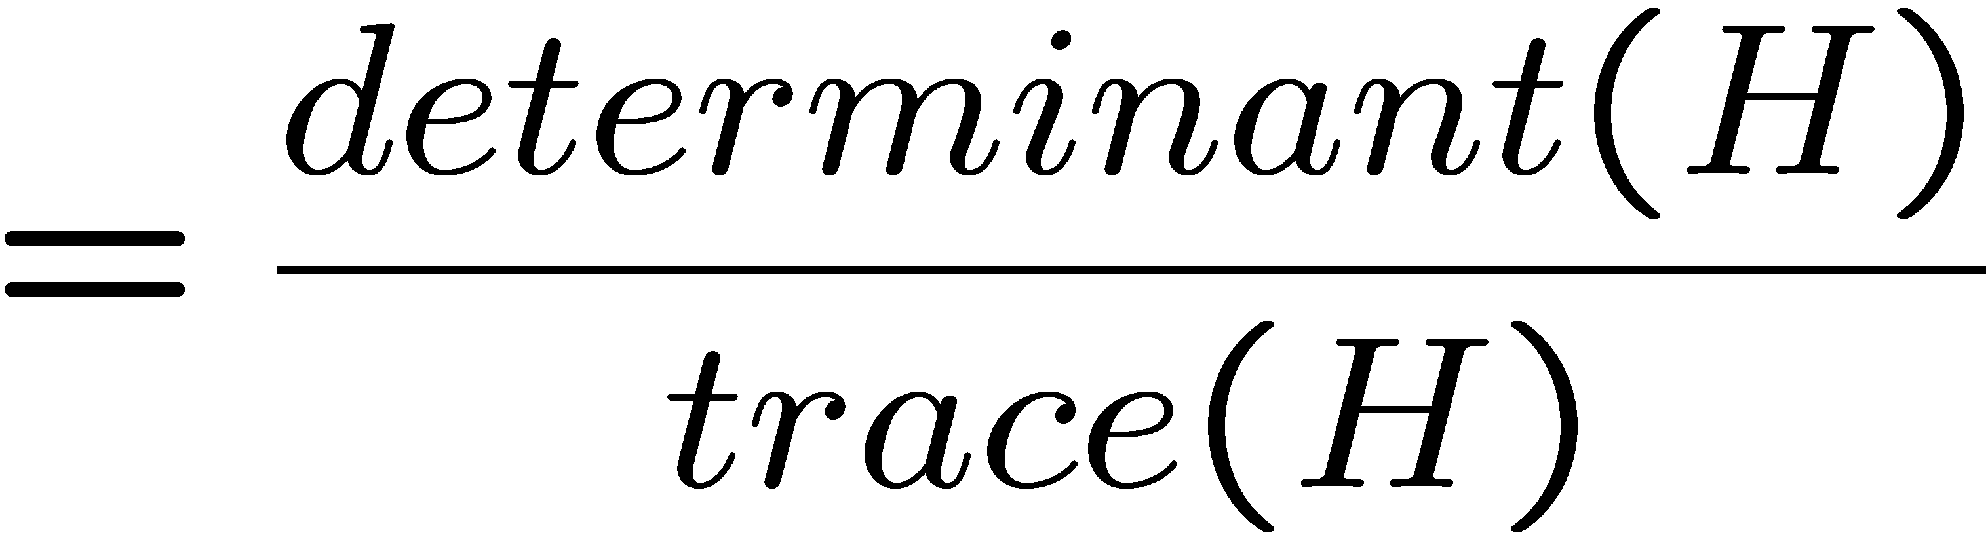
The Harris operator
λ_{min} is a variant of the “Harris operator” for feature detection
  The trace is the sum of the diagonals, i.e., trace(H) = h₁₁ + h₂₂
  Very similar to λ_{min} but less expensive (no square root)
  Called the Harris Corner Detector or Harris Operator
  Lots of other detectors, this is one of the most popular

Slide 39
Alternate Harris operator
will use an alternate definition of the Harris operator:

Slide 40

The Harris operator
Harris
operator

Slide 41
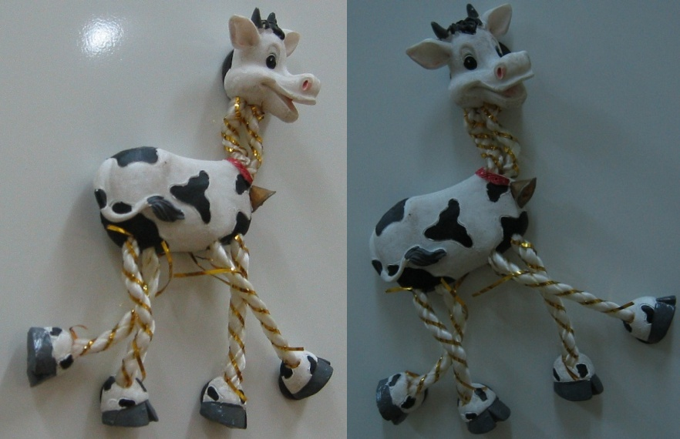
Harris detector example

Slide 42

f value (red high, blue low)

Slide 43

Threshold (f > value)

Slide 44

Find local maxima of f (non-max suppression)

Slide 45

Harris features (in red)

Slide 46


Weighting the derivatives
In practice, using a simple window W doesn’t work too well
Instead, we’ll weight each derivative value based on its distance from the center pixel

Slide 47












Harris Detector – Recap [Harris88]
0. Input image
Second moment matrix
1. Image derivatives
I_{x}
I_{y}
I_{x}²
I_{y}²
I_{x}I_{y}
2. Square of derivatives
3. Gaussian
filter g(s_{I})
g(I_{x}²)
g(I_{y}²)
g(I_{x}I_{y})
4. Cornerness function – both eigenvalues are strong
5. Non-maxima suppression
har

Slide 48
Harris Corners – Why so complicated?
Can’t we just check for regions with lots of gradients in the x and y directions?
  No! A diagonal line would satisfy that criteria
Current Window

Slide 49
Questions?

